Slide 1
Registers

Slide 2
Outline
Registers
Benefits of Registers
Basic Register
Shift Register
Bidirectional Shift Register with Parallel Load

Slide 3
Registers
Registers are common sequential devices.
They’re a good example of sequential analysis and design.
They are also frequently used in building larger sequential circuits.
Registers hold larger quantities of data than individual flip-flops.
Registers are central to the design of modern processors.
There are many different kinds of registers

Slide 4
Benefits of registers
Flip-flops are limited because they can store only one bit.
Two flip-flops are used for two-bit counters.
Most computers work with integers and single-precision floating-point numbers that are 32-bits long.
A register is an extension of a flip-flop that can store multiple bits.
Registers are commonly used as temporary storage in a processor.
They are faster and more convenient than main memory.
More registers can help speed up complex calculations.

Slide 5
A basic register
Basic registers are easy to build. We can store multiple bits just by putting a bunch of flip-flops together!
A 4-bit register is shown on the right, and its internal implementation is below.
This register uses D flip-flops
it’s easy to store data without worrying about flip-flop input equations.
All the flip-flops share a common CLK and CLR signal.

Slide 6
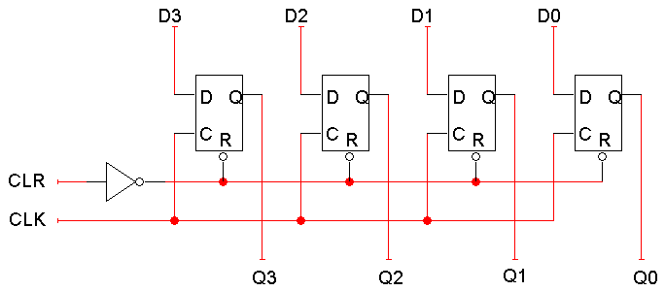
Figure: A 4-bit basic Register

Slide 7
Shift register
A shift register “shifts” its output once every clock cycle.
SI is an input that supplies a new bit to shift “into” the register.
For example, if on some positive clock edge we have: SI = 1 Q₀-Q₃ = 0110
then the next state will be: Q₀-Q₃ = 1011
The current Q₃ (0 in this example) will be lost on the next cycle.
Q₀(t+1) = SI
Q₁(t+1) = Q₀(t)
Q₂(t+1) = Q₁(t)
Q₃(t+1) = Q₂(t)

Slide 8
Bidirectional shift register with parallel load
A bidirectional shift register is one in which the data can be shifted either left or right. It can be implemented by using gate logic that enables the transfer of a data bit from one stage to the next stage to the right or to the left, depending on the level of a control line.

Slide 9
Bidirectional shift register with parallel load (cont.)
DOWN
S1 | S0 | Register Operation
0 | 0 | No change (Hold)
0 | 1 | Shift Left (down)
1 | 0 | Shift Right (up)
1 | 1 | Parallel Load
HOLD
Parallel load
UP

Slide 10
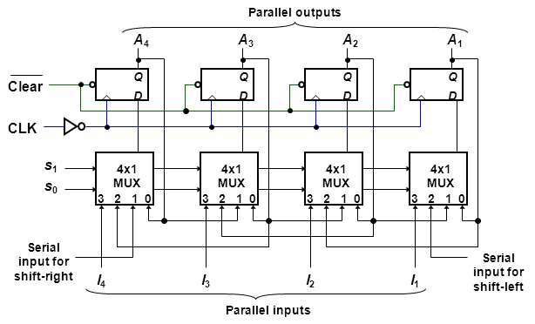
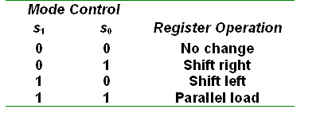
Figure: Bidirectional Shift Register with Parallel Load

